Slide 1
Unit 4- Lecture 23
Plan space planning

Slide 2
Plan space planning
Plan space contains all possible plans and plan space planning searches in this space for a plan that is right.
It moves from one plan to another plan adding some actions at any part.
That means it picks up another plan from plan space.
Thus it moves from one plan to another.
In (linear) planning that we have seen so far, the system looks at the current state and the goal, and terminates when the state connects to the goal state.
It acts linearly, adding one action at a time, looking at the preconditions and focusing on the current state.
The process also adds a state resulted from that action.

Slide 3
In GSP, it is the reverse process but logically the same.
We begin from the goal state; find an action which can convert a previous state into this state, check for the preconditions and so on.
The idea is to have continuous focus on the current state, deciding the next move, without looking at the over plan.
Unlike GSP and few other earlier planning methods used by researchers, where current state is the focus of attention and the state is added as the next or previous state only, the plan space planning allows actions to be added at any given place in the plan and thus sometimes this method is also denoted as nonlinear planning.

Slide 4
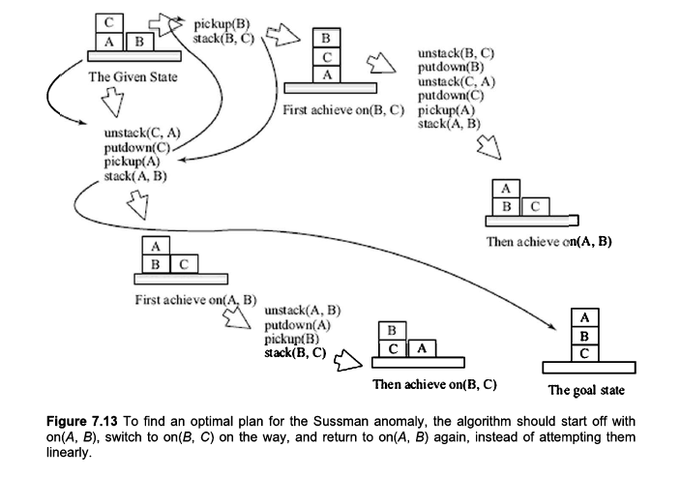

Slide 5
The plan-space planning does not work on the strict ordering of states.
The actions that are listed in the plan do not follow strict ordering.
Some actions are needed to be done on order and some are not.
That is why this process is also known as partial order planning.
Interestingly the process begins with some set of actions in a plan and adds actions at suitable places in the plan.
The process looks at quite a few things at a time.
It looks at actions and their prerequisites or preconditions to decide if they are applicable at a specific place in the plan or not.
Plan space planning also looks as if an order is a must for some actions.

Slide 6
For example unless you pick up a block resting on some block, you cannot use that block.
So action On(X,Y) can only happen if PlaceOnTable(Z) happens in case of Z being on top of Y right now.
Thus these two actions must be arranged in order.
Sometimes the actions can be done without ordering.
If we want to place A over B and C over D when both B and D are resting on table, both actions can take any sequence.
Another point that plan space planning takes into account is priority of what to do next.
Unlike goal stack planning where one picks up and solves one component and only then solves another, PSP picks up actions after actions and see if some other action is needed to be executed in the middle.

Slide 7
For example while solving On(B,A) if it finds an action threatening to undo On(B,A) later, it might schedule that action much later, after the complete effect of On(B,A) is over, or it might schedule is before and complete it, so it cannot interfere in the process of placing B over A or disturb it later.
PSP defines and uses actions which can be a potential threat to other actions, or might change preconditions of actions to follow as flaws.
It works in the way that flaws are eliminated while proceeding further.
Once all flaws are guaranteed to be out, PSP guarantees a valid and optimal plan unlike GSP.

Slide 8
This method has the same advantage of the global heuristic functions have over local heuristic functions.
The PSP looks at the complete plan rather than a single state at a time and can escape problems associated with local exploration.
The linear planning methods like GSP look at local (current) state and decide next or previous move irrespective of other moves.
That means the current move might invalidate something achieved earlier.
The current move also prohibits some other move that is must for achieving goal and thus the current move is to be undone at later stage when one cannot proceed without undoing that move.

Slide 9
Such complications can be avoided when plan space planning is used.
In some cases reordering will get an optimized solution but in some cases not.
Unlike GSP, the PSP looks at the entire plan and add or remove actions from anywhere in the plan.
This gives a global vision to the decision maker and thus overall impact of adding or removing an action.
As plan space planning does not focus on any one component continuously, it can avoid problems which linear methods like GSP introduces.
It is possible to shift attention in the middle of the process to avoid problems like Sussman’s anomaly.

Slide 10
The PSP is about generating sequences of actions which represent correct plan.
Each action has two things associated with them, first is prerequisites or preconditions.
Without the prerequisites being true, the action cannot be performed.
The other part is called of an action.
The effect is the changes the action provides to current state.
The initial node in plan space planning is characterized by two actions, viz. A₀ and A∞.
These two actions are part of every plan and are special as they indicate initial and final actions.
A₀ is the prerequisite for the start state and has no preconditions itself.

Slide 11
Thus every plan begins with it.
A∞ has no effect and the precondition is the goal state.
That means the action describes the final state.
The initial node (start node) thus contains both, the start state and description of what goal looks like.
It is the first plan which we will continue to modify unless we get a final valid plan.
Thus we will begin with a simplest plan A₀ -->A∞.
Now we will check if this is a valid plan that means if all effects of action A₀ matches with prerequisites of A∞, we are done.
Obviously we cannot solve problems using these two actions in most but trivial cases.

Slide 12
We need other actions.
Thus as planning proceeds further, we need to add more actions.
As mentioned before, this is non-linear process and thus we can add actions wherever we deem it fit, irrespective of any order.
The PSP allows us to add links between actions apart from actions themselves.
The symbol that we have used,(-->) indicates the link.
Sometimes the symbol α is also used.
Thus the idea of order changes a bit. One type of link is called ordering link.
This link describes order.

Slide 13
For example if we say that A_{n} A_{m}, that means A_{n} must occur before A_{m}.
One of the examples of ordering link is A₀ α A∞.
This is a default link which clearly indicates that first action must occur before the last one.
Another type of link is also possible.
When a link is written as (A_{n}, P, A_{m}) it indicates a causal link.
The P indicates prerequisite of action A_{n}, which is an effect of action A_{m}.
In a way, we are telling that A_{m} produces prerequisites for A_{n}.
This by no way means that A_{n} and A_{m} are to be ordered accordingly.

Slide 14
If A_{m}’s prerequisites are matched otherwise, it can execute without waiting for to happen.
Here P is known as a predicate, A_{m} is known as producer to P while A_{n}is known as consumer of P.
Additionally, this also has no constraint on A_{n} to occur without A_{m}, it can happen without any need to be followed by A_{m}, this relation only indicates the relation between these two events.
Another important characteristic of a link is whether it is established or not.
An established link is a guarantee that action A_{n} gives support to the precondition of predicate P to action A_{m}.
That means this link is needed to be true for the plan.

Slide 15
That means that the algorithm must make sure that all established links are honored in the planning process.
When the link is not honored, it is known as clobbered.
If any link during the planning process is clobbered, the algorithm must declobber it.
That means it must make sure that the plan changes in a way that the link remains established.
A causal link may be clobbered by a threat.
If (A_{n}, P, A_{m}) is a causal link, we might have an action A_{x} in the plan, which can delete P.
That can happen in a few ways, one of them having negative P in the effect of A_{x}.

Slide 16
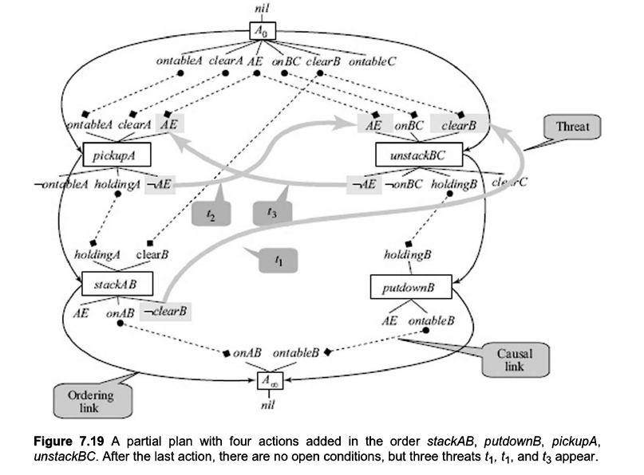

Slide 17
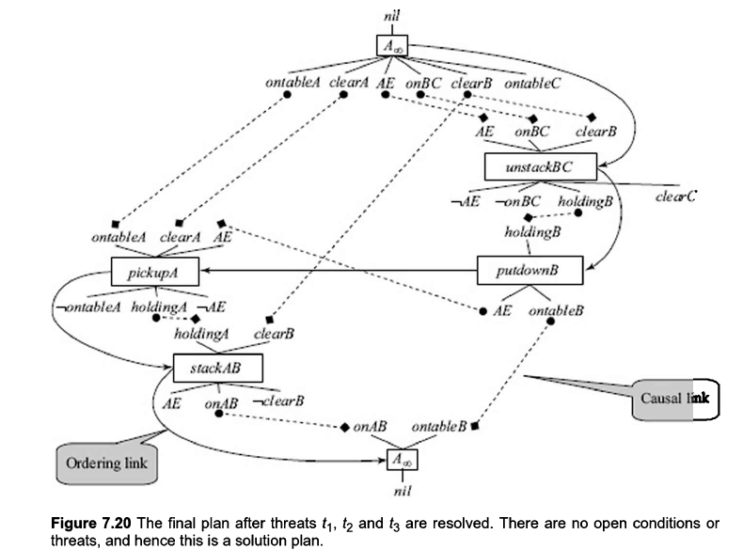

Slide 18
So when A_{x} gets executed, P becomes invalidated when action An is taken before.
That means if An is executed, we cannot have Ax in the plan till we have Am, if we have, it is going to clobber the link (An, P, Am).
For example, assume we have C is placed Over A and A is placed over B.
now, Free (A) is a precondition for action PlaceOntable(A).
The effect of PlaceOnTable(C) is Free(A).
Thus the causal link is (PlaceOnTable(C), Free(A), PlaceOnTable(A)).
Now if we have an action On(B,A) in plan which deletes Free(A).

Slide 19
Now if PlaceOnTop(B,A) executes before PlaceOnTable(A) after Free(A) is ensured, PlaceOnTable(A) cannot be executed.
We must need to undo On(B,A) to get back to Free(A) and only than PlaceOnTable(A) can be executed.
We can say that PlaceOnTop(B,A) is a threat to the causal link (PlaceOnTable(C), Free(A), PlaceOnTable(A)).
The preconditions which are linked with other action are called causal preconditions.
If there is no action associated with the precondition, we call it open precondition.
A solution plan cannot have any open preconditions or threats.

Slide 20
For example if PlaceOnTop (A,B) demands Free(B) and we have no action which can produce Free(B), Free(B) is an open precondition.
Like a threat, open preconditions invalidate the plan.
Open preconditions and threats are also known as flaws.
In fact it is possible to prove that if a partial plan has no flaws, it is a valid plan.
The PSP algorithm uses late binding strategy.
When it has to proceed without really knowing the
value of a variable, it does not instantiate a variable unless it has to.
For example it has to free A while some block is resting on A.
AI - Dr. Divyakant Meva

Slide 21
It might assume some block (it indicates the variable as ?X ?y etc) ?X such that On(?X,A) and thus execute PutOnTable(?X) to achieve free(A).
It does not associate any value to ?X right now.
That makes this process true for any block that might be resting on A.
Instead if we assume some other block, for example B, and execute PutOnTable(B), the process fail if C is resting on A when the PutOnTable actually executes.
There are a few more things that PSP introduces for making sure that there does not remain any flaws in the plan; i.e. some action cannot disrupt another.
AI - Dr. Divyakant Meva

Slide 22
Let us brief about three strategies used by PSP in the following.
Separation
This is a process of binding variables in a way that they do not assume values which lead to disruption.
For example On(B,C) should not happen when C is not resting on table (for our goal).
So if we make sure that in that case On(?X,?Y) cannot unify with On (B,C) it serves the purpose.
What is the meaning of this condition?
It says that you can plan to have anything on anything else except On(B,C) to have a valid plan.
AI - Dr. Divyakant Meva

Slide 23
Promotion
If there is an action which is a threat to a causal link, promote that action to happen before it can disrupt that causal link.
Thus the action gets over before causal link comes into effect and cannot disturb the causal link.
Demotion
This is exactly opposite to promotion.
The action is hold off till the actions involved in that causal link gets over.
Thus when the action is applied the effect of the causal link is already completed so there is no harm to execute that action now.
AI - Dr. Divyakant Meva

Slide 24
In fact the PSP is quite complex involving variable binding or instantiating, unifying a variable with another, matching with partial constructs and so on which we do not elaborate further.

